Slide 1
VP3300 Demo

Slide 2
Search the device’s Name from BT list of phone, there is no need to pair the device

Slide 3
Install and Launch VP3300 SDK Demo (included in the Android SDK package:

Slide 4
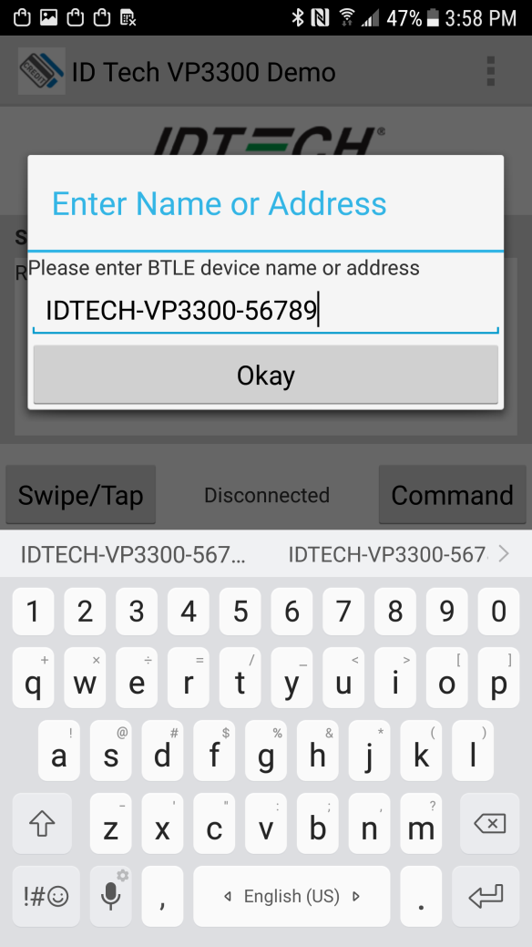
Select VP3300(Bluetooth) after tapping the 3 dots on the top right , enter the device name found previously and press Okay

Slide 5
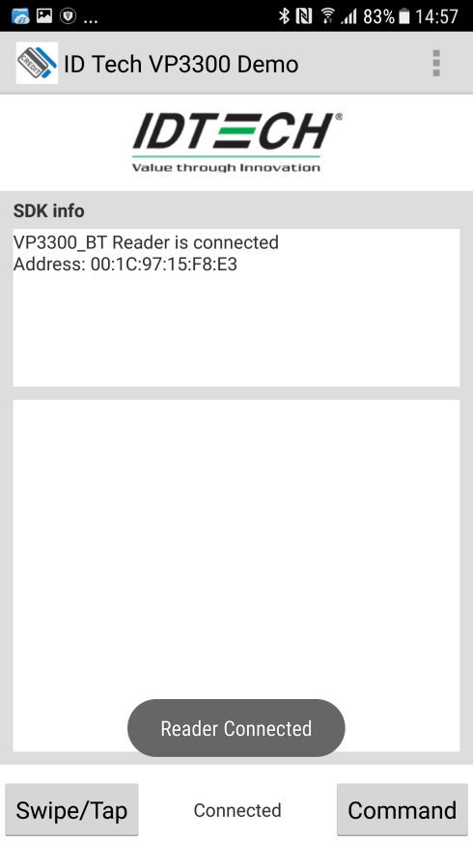
Push the BT pairing button on the side of the reader
When the reader is pairing, the top LED on the back of the reader will flash blue (500ms on, 500ms off)
After the device is paired, the top LED will flash blue 200ms on, 1500ms off, and SDK shows “Connected”

Slide 6
Once connected, check the device S/N number first to make sure is communication is good

Slide 7
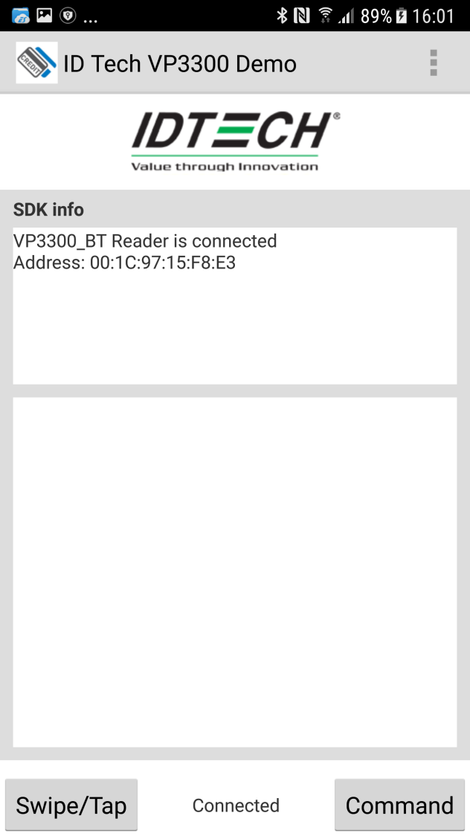
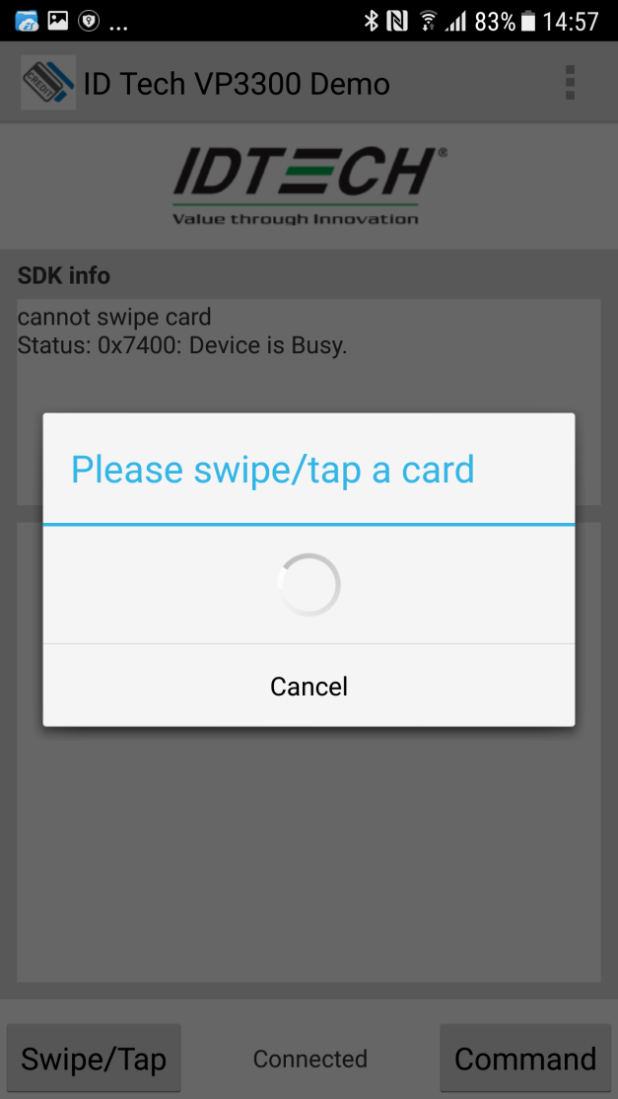
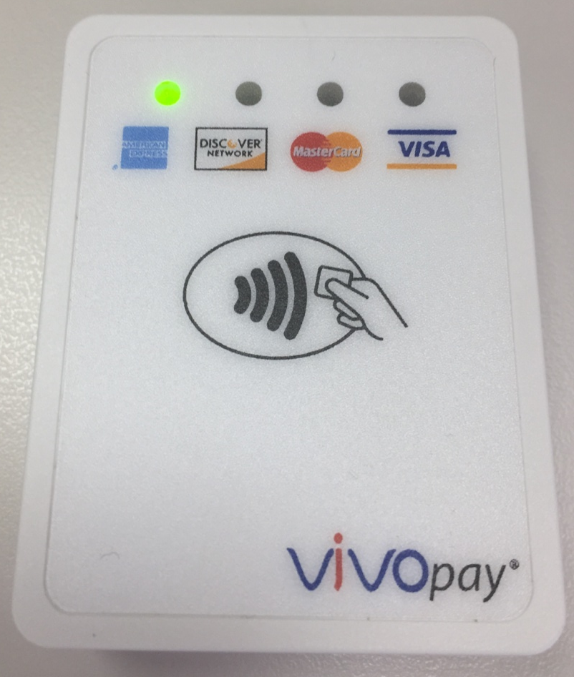
Start MSR/Contactless transaction test
Press Swipe/Tap
Waiting for swipe/tap
The leftmost LED in the front will be ON

Slide 8
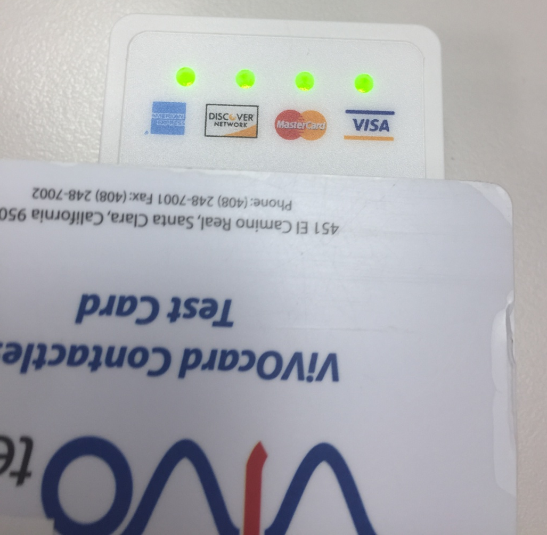
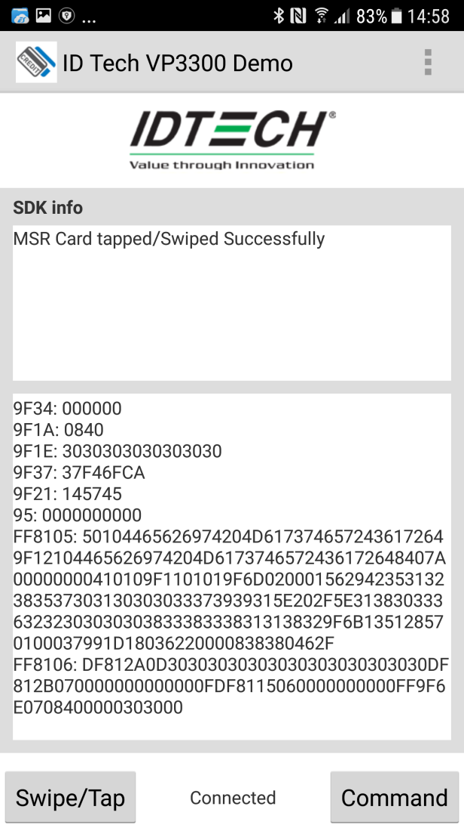
Start MSR/Contactless transaction test (Cont.)
Swipe/Tap a Card
Reader will sound a long Beep with 4 front LEDs turned on and show the related card information when the card is being read successfully.

Slide 9
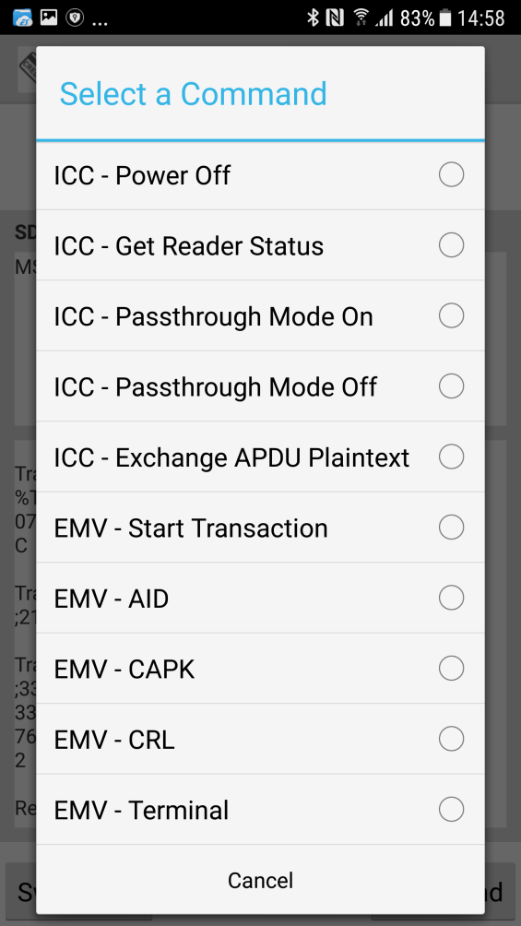
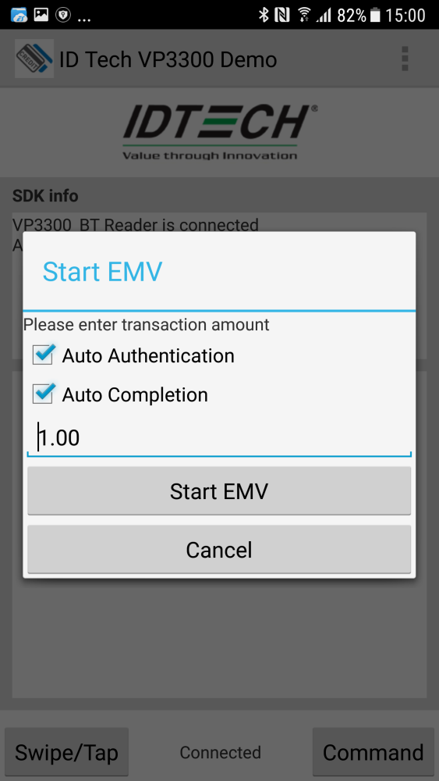
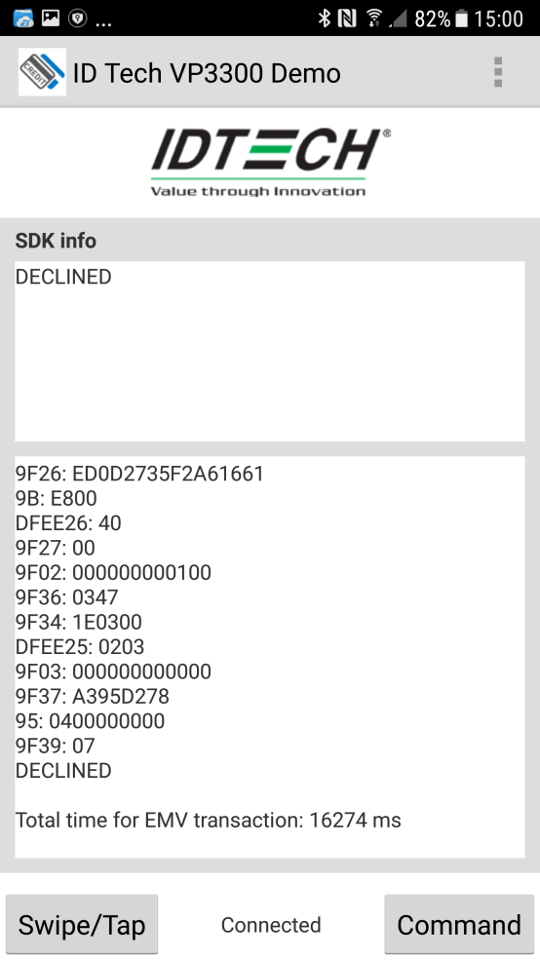
Start EMV Contact transaction test
Select the command from the 3-dotted menu:
Insert the Card:

Slide 10
Hints:
Fully charge the device before testing the reader.
When you connect a different reader, please exit the SDK Demo and then re-launch it so the SDK Demo will reconnect to the new device selected
When the reader powers off, the SDK Demo will disconnect, push the pairing button on the side of the reader will wake it up and it will trigger the SDK Demo reconnect to it automatically.
When you start a transaction, please swipe/tap/insert the card within 20 secs, otherwise the device will power off with the transaction cancelled and send the “timeout” response to the SDK Demo.
By default, 5 secs after you start the transaction, device will go to sleep mode with the connected LED turned off, you can still swipe/tap/insert the card within 15secs, the reader will wake up and finish the transaction.

